Slide 1
Hotel Revolution 2014s
Software Engineering Project
Team Members:
Sara Zanzottera, Gianpaolo Branca, Simone Mosciatti and Giovanni Pelosi

Slide 2
Project’s Scope
The software aim to help the staff to manage the rooms of the structure. It will help to identify free rooms in a particular period of time thus helping to understand if it is possible to satisfy clients’ requests.
Also it will keep count of how many days a particular client has been host of the structure helping the manager to bill accordingly

Slide 3
Requirements (and Main Functions)
Will allow the reception to be quick and extremely precise in answering any inquiry from possible guests.
Will let fast booking operation by the hotel staff
Will show all the possible options available for a guest and Will let the staff know which rooms will be free sooner
Will let the staff know who is guesting in a particular room and how long a guest has been in the hotel
Will provide two level of authentication, one from the staff and one from the manager, the manager will be able to access all the information while some sensitive information (revenue) won't be show to the staff.

Slide 4
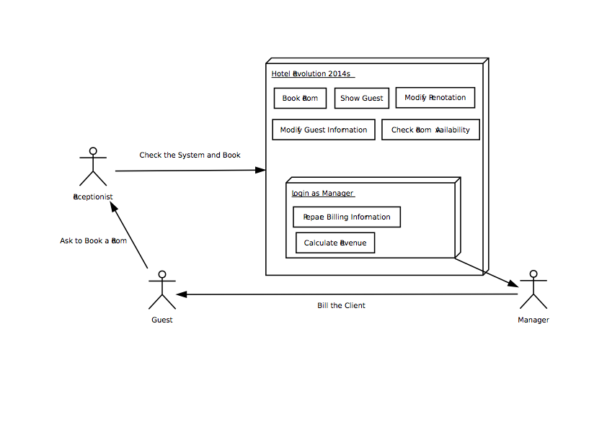
Use-CASE Model Diagram - System

Slide 5
The Use-Case shows which are the main purpose of the System and how the staff interact with it.
The Actors are:
Receptionist
Guests
Manager
Only the receptionist and the manager can interact directly with the System, so they are the link between Guests and System.

Slide 6
Guest
A person or a group of people who want to book one or more rooms
He interacts with the System only through the Receptionist and/or the Manager
Can :
book/modify/delete a reservation through the receptionist
ask the bill to the manager

Slide 7
Receptionist
The main User of the System; It is the link between the User and the System.
Can :
add/modify/delete a reservation
check rooms availability and the features of every room
show/add/modify/delete guest informations

Slide 8
Manager
The only person who can access to the entire System, in particular to the sensitive information (revenue)
Can :
prepare the bill informations for the guest
calculate the partial/total revenue
have a look on the hotel’s general situation

Slide 9
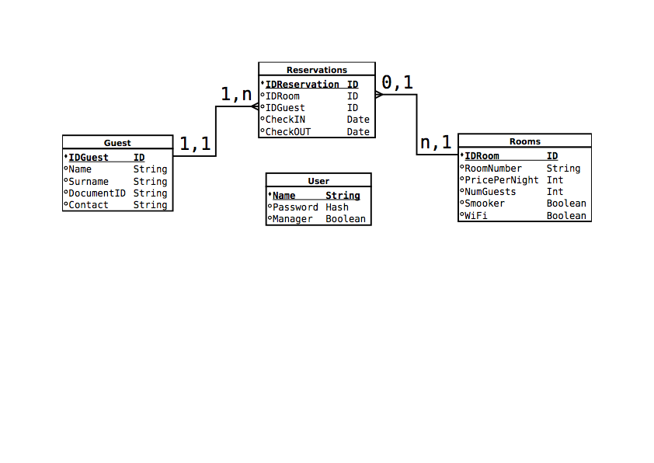
Data Model

Slide 10
There are 4 entities :
guest
reservations
rooms
user
guest, reservations and rooms are connected while user is a separated entity.

Slide 11
Conclusion
we have tried to design a System as simple as possible, because in this way it will be easy to use, quick, and easy to expand

Slide 12
Next Presentation will Include
The detailed process modeling
The system context data flow diagram
The detailed data modeling
And a lot more
See you on October 23

